Slide 1
Google test/mock
An Introduction to

Slide 2
Agenda
Basic Concepts
ASSERT vs EXPECT
AAA: Arrange-Act-Assert
TEST
TEST_F
TEST_P
TYPED_TEST_P
Mocking
Assertion
Matchers

Slide 3
Basic Concepts
Assertions: statements that check whether a condition is true. An assertion’s result can be success, nonfatal failure, or fatal failure.
Tests: use assertions to verify the tested code’s behavior. If a test crashes or has a failed assertion, then it fails; otherwise it succeeds.
Test Suite: contains one or many tests.
Test Fixture: a test suite need to share common objects and subroutines, you can put them into a test fixture class.
Test Program: can contain multiple test suites.

Slide 4
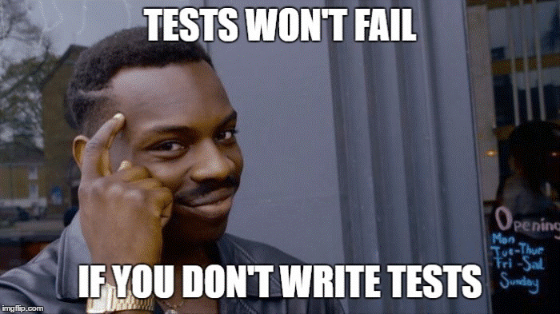
ASSERT vs EXPECT
ASSERT
If a failure occurs, it aborts the current function.
Using macro ASSERT_*
EXPECT
If a failure occurs, the program continues normally.
Using macro EXPECT_*

Slide 5
AAA: Arrange-Act-Assert
Divide your test method into three sections:
Arrange: Only have code required to setup that specific test (like the objects must be created, mocks setup and potentially expectations would be set).
Act: Invocation of the method being tested.
Assert: Check whether the expectations were met.

Slide 6
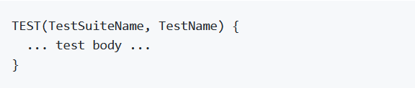
TEST
To create a simple test
Using TEST()

Slide 7

TEST

Slide 8
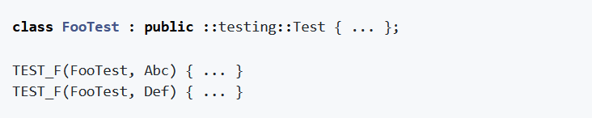
TEST_F
Using the Same Data Configuration for Multiple Tests
Using TEST_F()

Slide 9
TEST_F
Derive a class from testing::Test. Start its body with protected.
Inside the class, declare any objects you plan to use.
If necessary, write a default constructor or SetUp() function to prepare the objects for each test.
If necessary, write a destructor or TearDown() function to release any resources you allocated in SetUp().
If needed, define subroutines for your tests to share.

Slide 10
TEST_F
constructor/destructor vs SetUp()/TearDown()
C++ does not allow virtual function calls in constructors and destructors.
In the body of a constructor (or destructor), it’s not possible to use the ASSERT_xx macros.
If the tear-down operation could throw an exception, you must use TearDown().

Slide 11
TEST_F

Slide 12
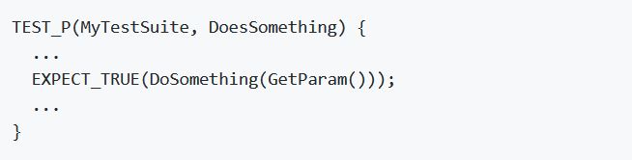
TEST_P
Value-Parameterized Tests
Test your code with different parameters without writing multiple copies of the same test.

Slide 13
TEST_P

Slide 14
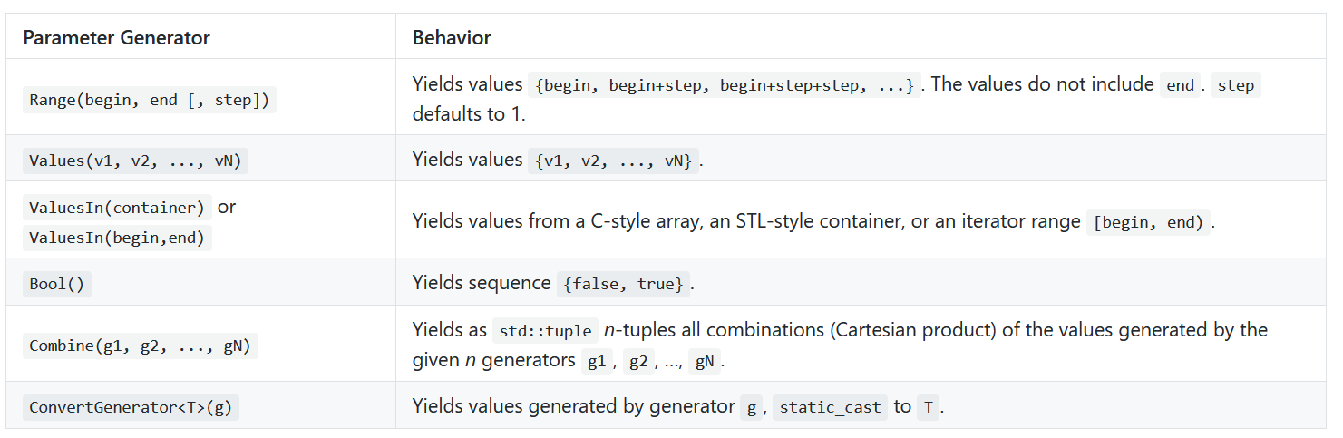
TEST_P

Slide 15
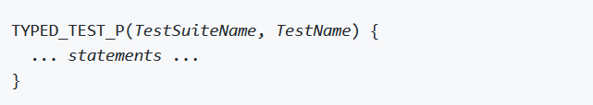
TYPED_TEST_P
Type-Parameterized Tests
Suppose you have multiple implementations of the same interface and want to make sure that all of them satisfy some common requirements.

Slide 16
TYPED_TEST_P

Slide 17
GMOCK
Remove unnecessary dependencies in tests and make them fast and reliable
Using MOCK_METHOD()
Using EXPECT_CALL()

Slide 18
GMOCK

Slide 19
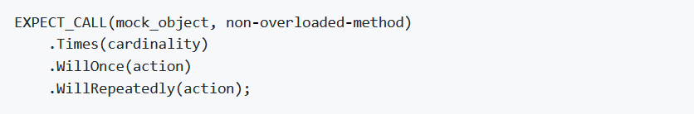
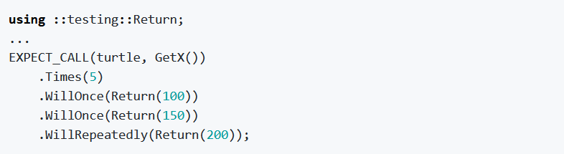
GMOCK

Slide 20
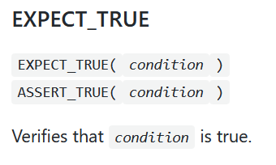
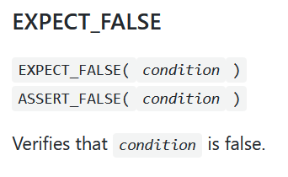
Assertions
Boolean Conditions

Slide 21
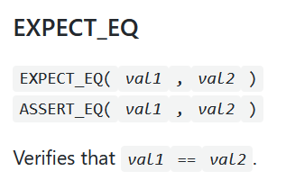
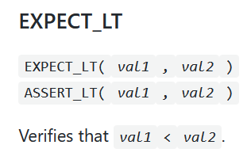
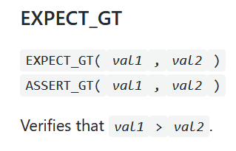
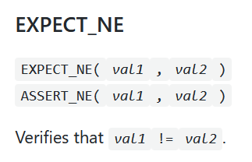
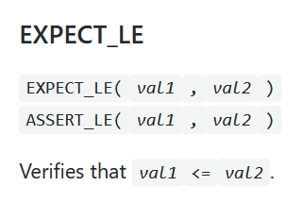
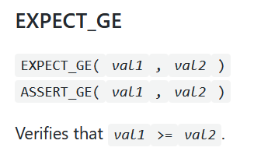
Assertions
Binary Comparison

Slide 22
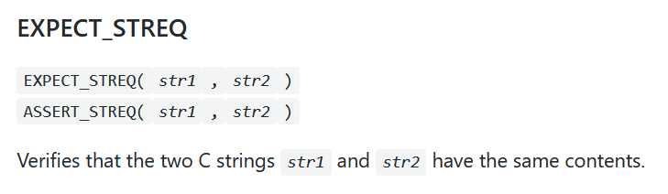
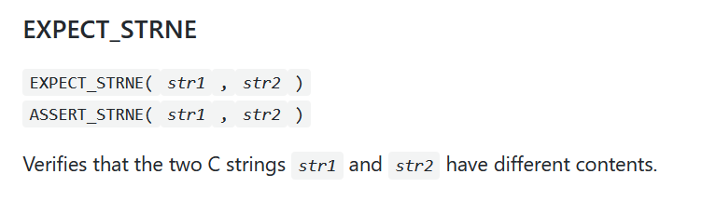
Assertions
String Comparison

Slide 23
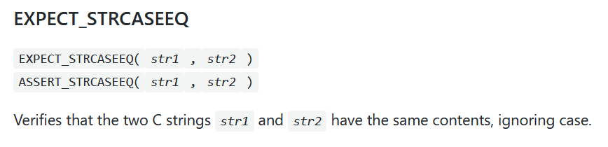
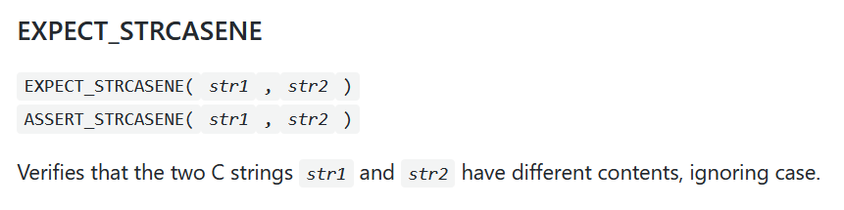
Assertions
String Comparison

Slide 24
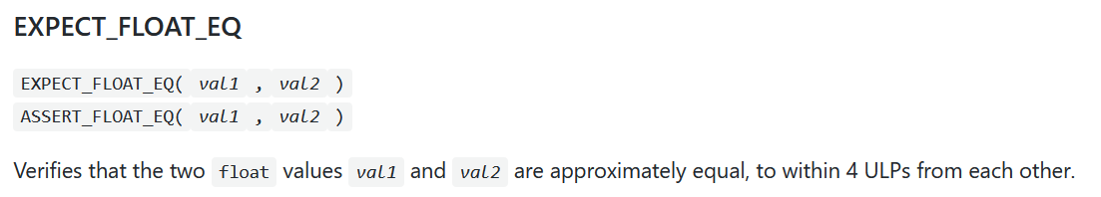
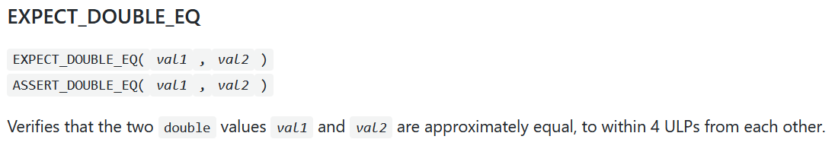
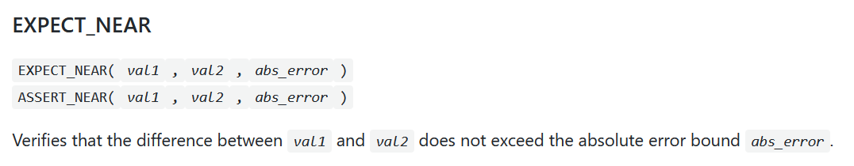
Assertions
Floating-Point Comparison

Slide 25
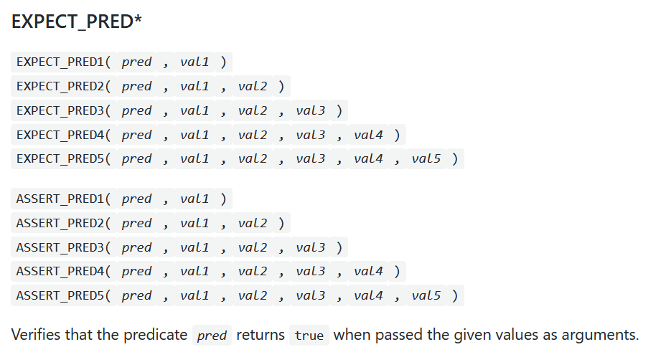
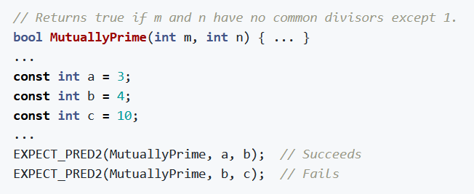
Assertions
Predicate Assertions

Slide 26
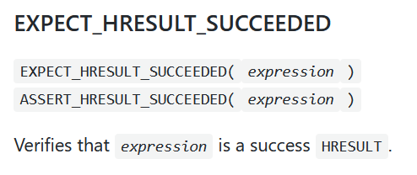
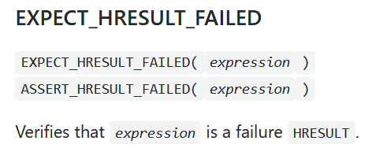
Assertions
Windows HRESULT Assertions

Slide 27
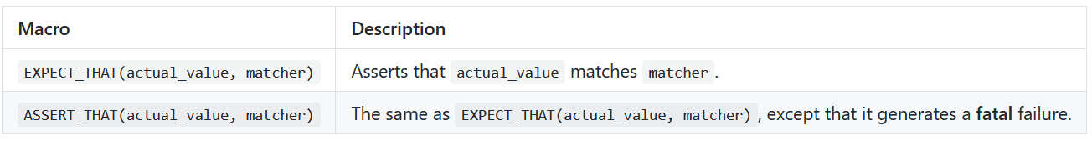
Matchers

Slide 28
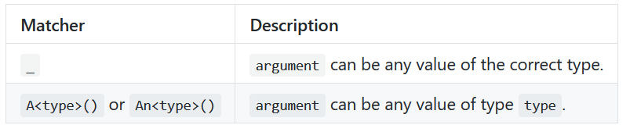
Matchers
Wildcard

Slide 29
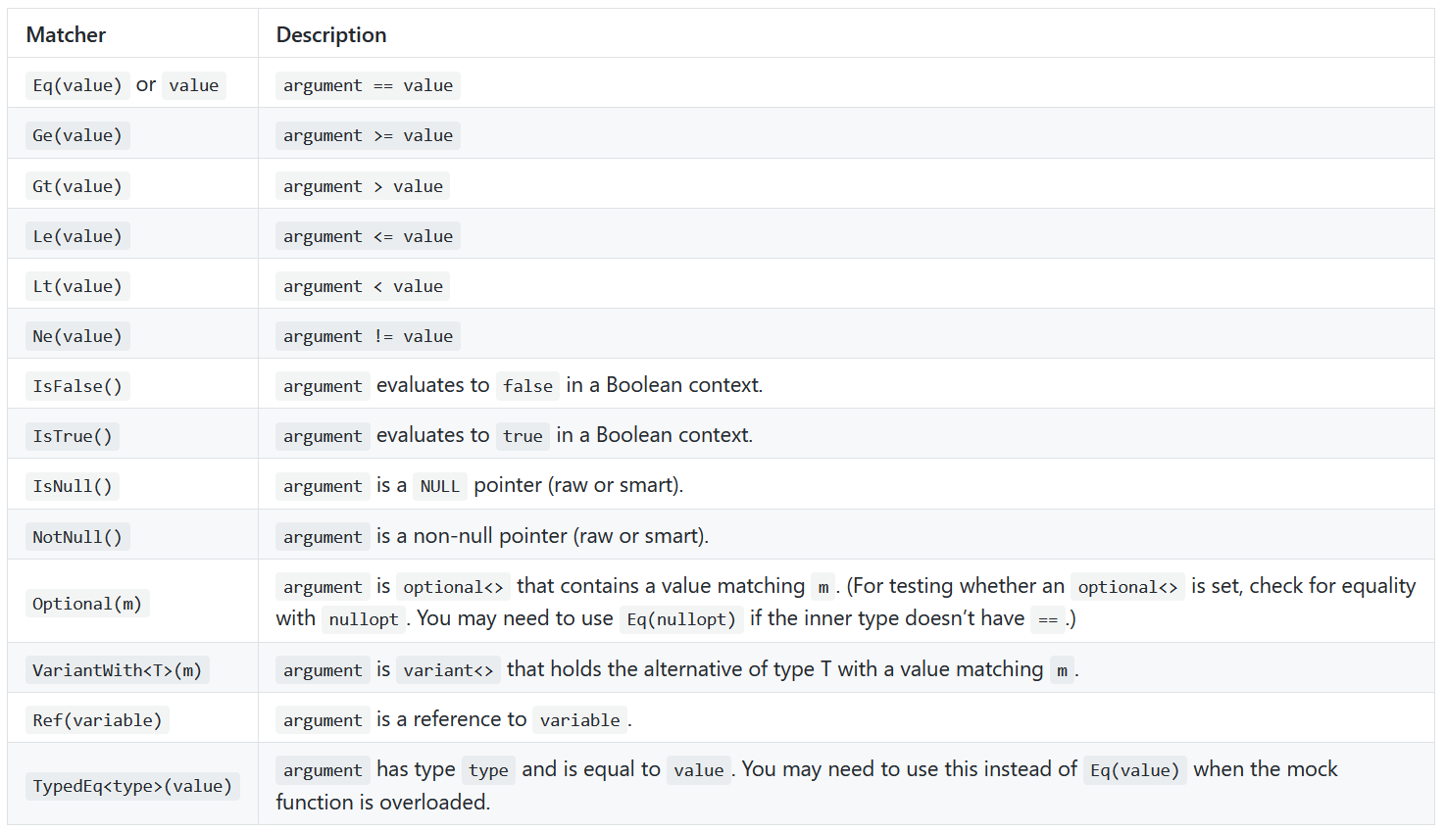
Matchers
Generic Comparison

Slide 30
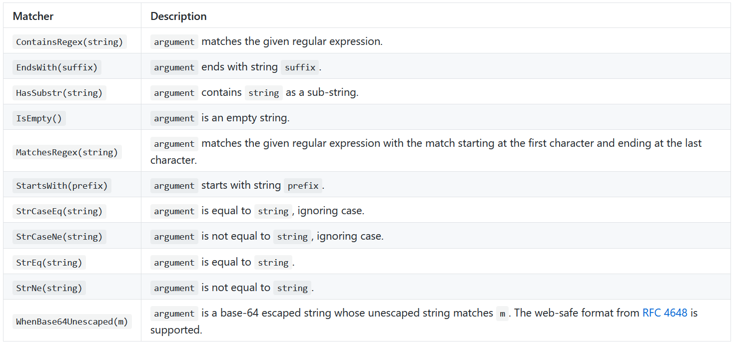
Matchers
String Matchers

Slide 31
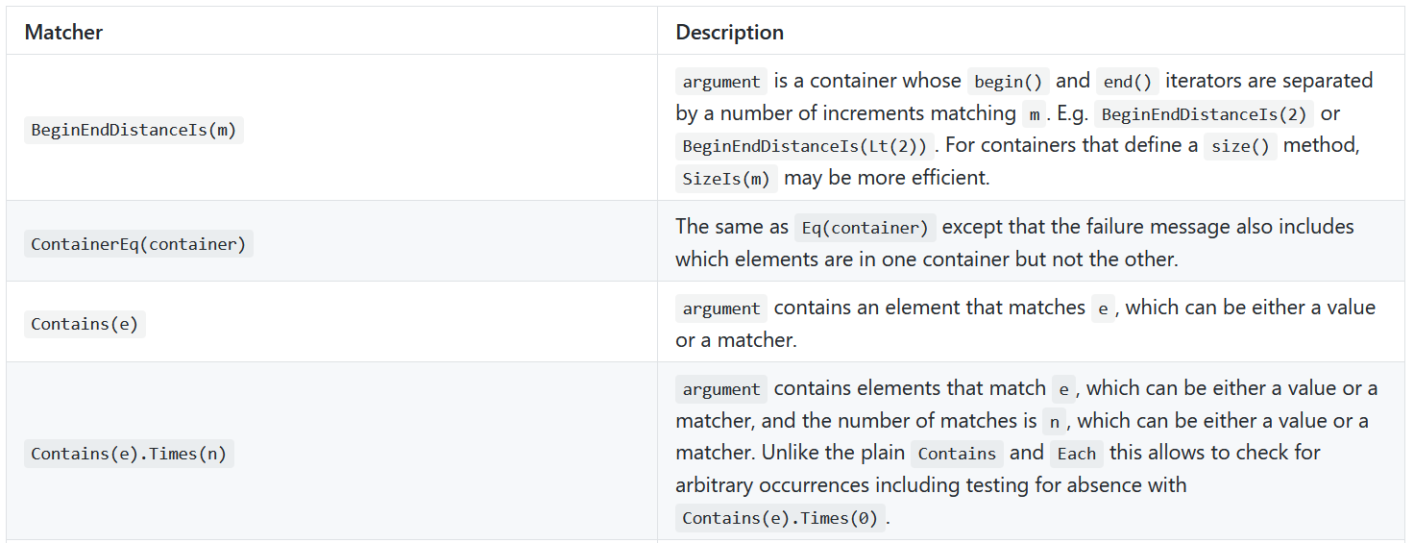
Matchers
Container Matchers

Slide 32
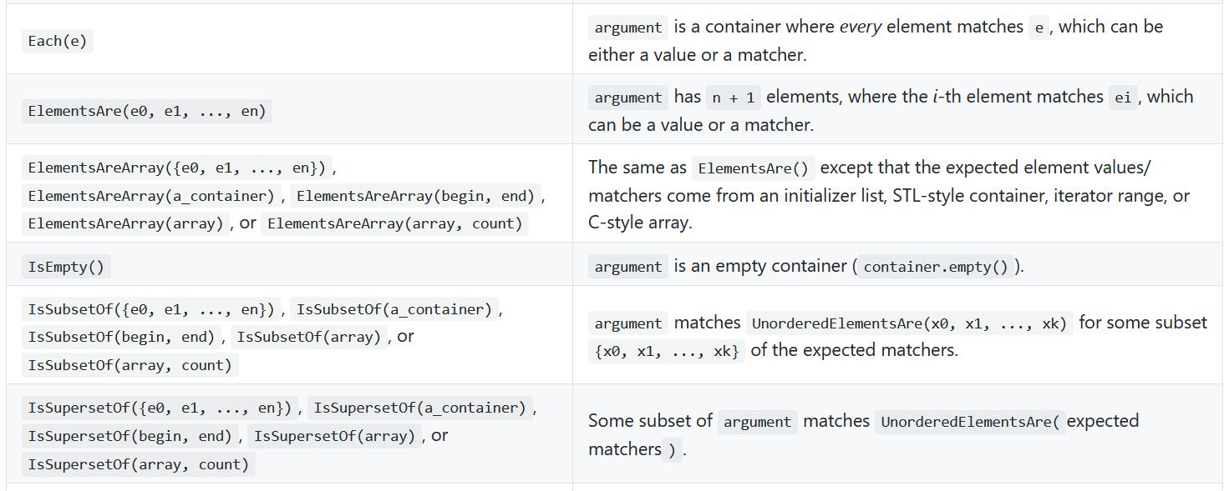
Matchers
Container Matchers

Slide 33
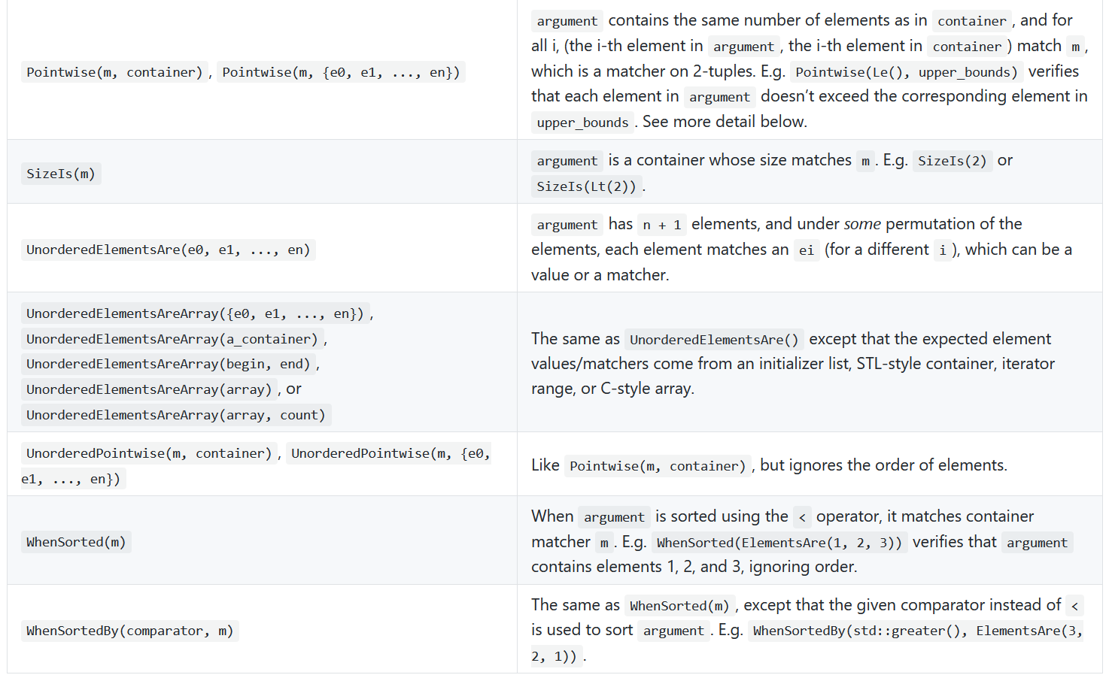
Matchers
Container Matchers

Slide 34
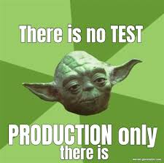
REF
http://google.github.io/googletest/
https://medium.com/@pjbgf/title-testing-code-ocd-and-the-aaa-pattern-df453975ab80

